Slide 1

Credit One Banking Services
Project Proposal
Understanding the Credit Limits and Lending of our Customers
<>

Slide 2
Process
STEP 1
STEP 3
STEP 5
Define the Goal
Evaluate and Critique the Model
Deploy and Maintain the Model
1
2
3
4
5
STEP 2
STEP 4
Collect and Manage Data
Present Results and Document
Created by Zumel and Mount

Slide 3
Step One – Define the Goal
One Project, Two Goals
1
Determine which potential customers are most likely to default
2
Determine how much credit balance to give customers

Slide 4
Step 2 – Collect and Manage Data
All data comes from Credit One’s external SQL server

Slide 5
Data Summary
Age, Marital Status, Gender, Education
Demographic Data
30201
customers
Limit Balance, Default
Target Variables
6 months
Billing and payment data

Slide 6
Management
The data warehouse is kept in secure servers on our team’s private computers.

Slide 7
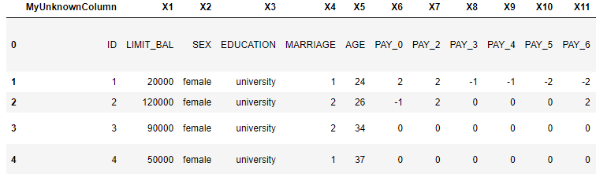
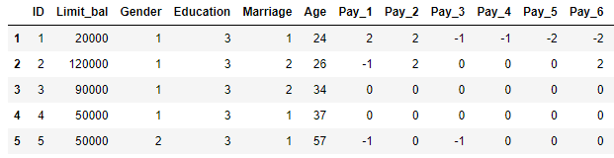
Data Issues
There were a few rows whose values were what we wanted to name the columns, while the columns were merely X#. This was easily fixed.
We assigned numbers to non-numeric values for easier parsing

Slide 8
Additional Useful Data
Many credit card companies use credit score and income information to determine who to approve for credit cards and how high to set an individual’s credit limit.
Credit Score
Income

Slide 9
The available data is from customers who have used Credit One for at least 6 months. We will not have this data for new customers. If we want to use this model to evaluate new customers, then we will have to make a model without the payment or billing information.

Slide 10
Step Three – Evaluate and Critique the Model
Initial Observations
The Limit Balance has a positive correlation with education, age, bill amount and pay amount, and a negative correlation with pay and default
Defaulting has a positive correlation with pay and a negative correlation with limit balance

Slide 11
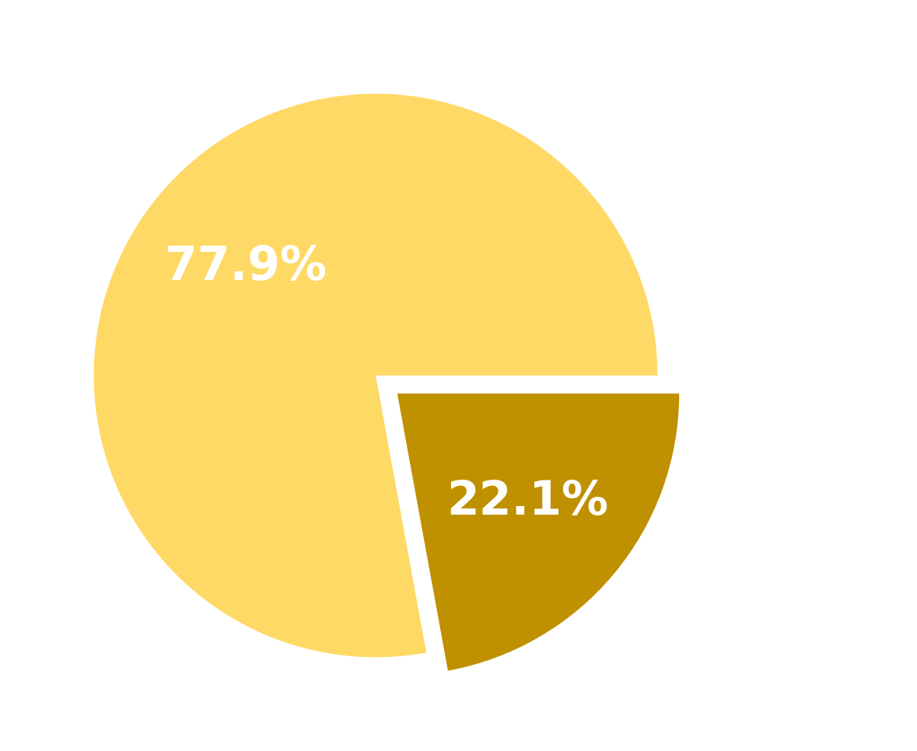
Defaults by Percentage
More than 1 in 5 creditors defaulted on their cards within the last 6 months

Slide 12
Step Four – Present Results and Document
The most important aspect of the model is how it will reduce Credit One’s spending on loans that are likely to default.
When presenting, we should emphasize the reduction of their losses and include any other findings that will help their business.
Finally, we will need to document the model for the team that will be running and maintaining it.

Slide 13
Step Five – Deploy and Maintain the Model
Going forward, we can use the algorithm to vet new prospective Credit One members and review current ones
As new data is gathered, the model we create may prove to be inaccurate or need updating.

Slide 14
STEP 1
STEP 3
STEP 5
Define the Goal
Misinterpreting the goal can lead to a model that is not useful.
Communication with management and careful monitoring of the model can prevent this problem.
Evaluate and
Critique the Model
We may have to try many iterations of the model to get the most accurate result.
Proper preparation and analysis before modeling can mitigate this
Deploy and
Maintain the Model
As new data emerges, the model may prove to be less accurate than originally thought.
We may need to revisit this problem when new data arises
1
2
3
4
5
STEP 2
STEP 4
Collect and Manage Data
Some of the data may not be useful for new customers.
There may be additional data that is helpful.
If we cannot get more data, then we will have to make the most of the data we have.
Present Results
and Document
We may not be able to create an accurate model with the data
While we may not always be able to accurately predict the target value, there may still be some useful information in the data.
Noting potential pitfalls that may occur along the way

